Slide 1
DBMS-Transactions

Slide 2
Terms
Transaction Concept
Transaction State
Serializability
Recoverability
Testing for Serializability.

Slide 3
Transaction Concept
A transaction is a unit of program execution that accesses and possibly updates various data items.
A transaction must see a consistent database.
During transaction execution the database may be inconsistent.
When the transaction is committed, the database must be consistent.
Two main issues to deal with:
! Failures of various kinds, such as hardware failures and system crashes
! Concurrent execution of multiple transactions

Slide 4
ACID Properties
To preserve integrity of data, the database system must ensure:
Atomicity. Either all operations of the transaction are properly reflected in the database or none are!
Consistency. Execution of a transaction in isolation preserves the consistency of the database(that means no other transaction should run concurrently when there is a transaction already running).
Isolation. Although multiple transactions may execute concurrently, each transaction must be unaware of other concurrently executing transactions. Intermediate transaction results must be hidden from other concurrently executed transactions.
! That is, for every pair of transactions Ti and Tj, it appears to Ti that either Tj, finished execution before Ti started, or Tj started execution after Ti finished.
Durability. After a transaction completes successfully, the changes it has made to the database persist, even if there are system failures.

Slide 5
Example of Fund Transfer
Transaction to transfer $50 from account A to account B:
1. read(A)
2. A := A – 50
3. write(A)
4. read(B)
5. B := B + 50
6. write(B)
Consistency requirement – the sum of A and B is unchanged by the execution of the transaction.
Atomicity requirement — if the transaction fails after step 3 and before step 6, the system should ensure that its updates are not reflected in the database, else an inconsistency will result.

Slide 6
Durability requirement — once the user has been notified that the transaction has completed (i.e., the transfer of the $50 has taken place), the updates to the database by the transaction must persist even if there are software or hardware failures.
Isolation requirement — if between steps 3 and 6 (of the fund transfer transaction) , another transaction T2 is allowed to access the partially updated database, it will see an inconsistent database.

Slide 7
Transaction State
Active, the initial state; the transaction stays in this state while it is executing
Partially committed, after the final statement has been executed.
Failed, after the discovery that normal execution can no longer proceed.
Aborted, after the transaction has been rolled back and the database restored to its state prior to the start of the transaction. Two options after it has been aborted:
restart the transaction – only if no internal logical error
kill the transaction
Committed, after successful completion.

Slide 8
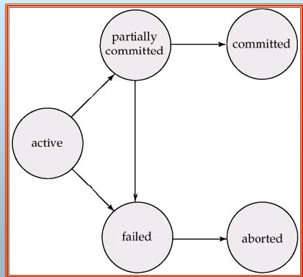
Transaction State

Slide 9
Concurrent Executions
Multiple transactions are allowed to run concurrently in the system. Advantages are:
increased processor and disk utilization, leading to better transaction throughput: one transaction can be using the CPU while another is reading from or writing to the disk
reduced average response time for transactions: short transactions need not wait behind long ones.
Concurrency control schemes – mechanisms to achieve isolation, i.e., to control the interaction among the concurrent transactions in order to prevent them from destroying the consistency of the database.

Slide 10
Schedules
Schedules – sequences that indicate the chronological order in which instructions of concurrent transactions are executed
a schedule for a set of transactions must consist of all instructions of those transactions
must preserve the order in which the instructions appear in each individual transaction.

Slide 11
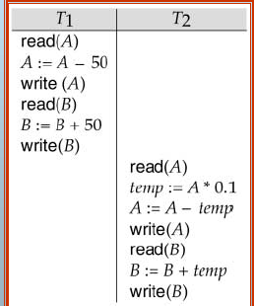
Example Schedules
Let T1 transfer $50 from A to B, and T2 transfer 10% of the balance from A to B. The following is a serial schedule, in which T1 is followed by T2.

Slide 12
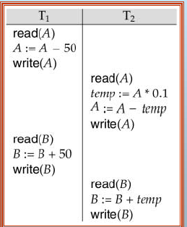
Continue….
Let T1 and T2 be the transactions defined previously. The following schedule is not a serial schedule, but it is equivalent to Schedule 1.

Slide 13
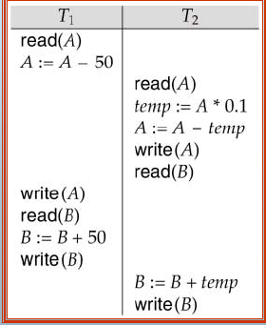
The following concurrent schedule (Schedule 4 in the text) does not preserve the value of the sum A + B

Slide 14
Serializability
Basic Assumption – Each transaction preserves database consistency.
Thus serial execution of a set of transactions preserves database consistency.
A (possibly concurrent) schedule is serializable if it is equivalent to a serial schedule.
Different forms of schedule equivalence give rise to the designs of:
1. conflict serializability
2. view serializability

Slide 15
Conflict Serializability
Instructions li and lj of transactions Ti and Tj respectively, conflict if and only if there exists some item Q accessed by both li and lj, and at least one of these instructions wrote Q.
1. li = read(Q), lj = read(Q). li and lj don’t conflict. (Swap)
2. li = read(Q), lj = write(Q). They conflict. (Don’t Swap)
3. li = write(Q), lj = read(Q). They conflict. (Don’t Swap)
4. li = write(Q), lj = write(Q). They conflict. (Don’t Swap)
Intuitively, a conflict between li and lj forces a (logical) temporal order between them.
If li and lj are consecutive in a schedule and they do not conflict, their results would remain the same even if they had been interchanged in the schedule.

Slide 16
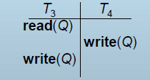
Conflict Serializability (Cont.)
If a schedule S can be transformed into a schedule S´ by a series of swaps of non-conflicting instructions, we say that S and S´ are conflict equivalent.
We say that a schedule S is conflict serializable if it is conflict equivalent to a serial schedule ! Example of a schedule that is not conflict serializable:
We are unable to swap instructions in the above schedule
to obtain either the serial schedule < T3, T4 >, or the serial
schedule < T4, T3 >.

Slide 17
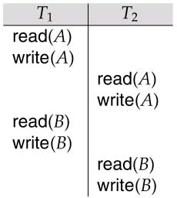
Conflict Serializability (Cont.)
Schedule 3 below can be transformed into Schedule 1, a
serial schedule where T2 follows T1, by series of swaps of
non-conflicting instructions. Therefore Schedule 3 is conflict
serializable.

Slide 18
View Serializability
Let S and S´ be two schedules with the same set of transactions. S and S´ are view equivalent if the following three conditions are met:
1. For each data item Q, if transaction Ti reads the initial value of Q
in schedule S, then transaction Ti must, in schedule S´, also read
the initial value of Q.
2. For each data item Q if transaction Ti executes read(Q) in
schedule S, and that value was produced by transaction Tj (if
any), then transaction Ti must in schedule S´ also read the value of
Q that was produced by transaction Tj .
3. For each data item Q, the transaction (if any) that performs the
final write(Q) operation in schedule S must perform the final
write(Q) operation in schedule S´.
As can be seen, view equivalence is also based purely on reads and writes alone.

Slide 19
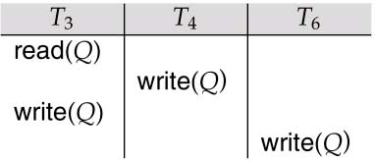
View Serializability (Cont.)
A schedule S is view serializable it is view equivalent to a serial schedule.
! Every conflict serializable schedule is also view serializable.
! Schedule 9 (from text) — a schedule which is view-serializable but not conflict serializable.
! Every view serializable schedule that is not conflict serializable has blind writes.

Slide 20
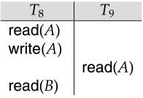
Recoverability
Need to address the effect of transaction failures on concurrently
running transactions.
Recoverable schedule — if a transaction Tj reads a data items previously written by a transaction Ti , the commit operation of Ti appears before the commit operation of Tj.
!The following schedule (Schedule 11) is not recoverable if T9 commits immediately after the read
If T8 should abort, T9 would have read (and possibly shown to the user) an inconsistent database state. Hence database must ensure that schedules are recoverable.

Slide 21
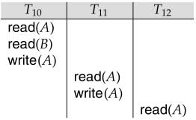
Recoverability (Cont.)
Cascading rollback – a single transaction failure leads to
a series of transaction rollbacks. Consider the following
schedule where none of the transactions has yet
committed (so the schedule is recoverable)
If T10 fails, T11 and T12 must also be rolled back.
Can lead to the undoing of a significant amount of work

Slide 22
Recoverability (Cont.)
Cascadeless schedules — cascading rollbacks cannot occur; for each pair of transactions Ti and Tj such that Tj reads a data item previously written by Ti, the commit operation of Ti appears before the read operation of Tj.
Every cascadeless schedule is also recoverable.
It is desirable to restrict the schedules to those that are cascadeless.

Slide 23
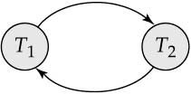
Testing of Conflict Serializability
Consider some schedule of a set of transactions T1, T2,..., Tn
Precedence graph — a direct graph where the vertices are the transactions (names).
We draw an arc from Ti to Tj if the two transaction conflict, and Ti accessed the data item on which the conflict arose earlier.
We may label the arc by the item that was accessed.
Example 1
A schedule is conflict serializable if and only if its precedence graph is acyclic.

Slide 24

Precedence Graph for
(a) Schedule 1 and (b) Schedule 2

Slide 25
References
https://www.db-book.com › slide-dir
Sixth Edition Avi Silberschatz Henry F. Korth
S. Sudarshan
Book-Database System Concepts.

Slide 26
END

